Slide 1
Smart City-Pune Transport
Pune City Transport

Slide 2
Contents
Introduction to Smart City
Current Scenario
Transformation into Smart City
Features of smart city
Proposed Idea
Issues and Challenges
Benefits of Transformation

Slide 3
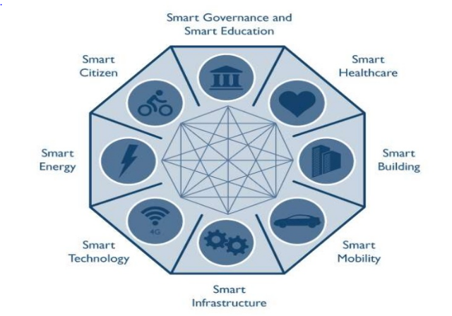
Introduction to Smart City
A smart city is an urban development vision
to integrate multiple information and communication technology (ICT) solutions
in a secure fashion to manage a city’s assets

Slide 4
Introduction to Smart City-Transportation
Transportation is a key pillar for quality of life in a city.
India needs a balanced focus in terms of improving/extending transportation infrastructure and leveraging smart technology solutions.
While, there is lots that needs to be done to improve/extend public transportation infrastructure in Indian cities and Government of India is investing in various national/ state/ local initiatives to improve public transportation.
There is also need to leverage Smart Technology Solutions to quickly improve efficiency/capacity of public transportation and to create high quality public transportation system.

Slide 5
Transformation into Smart City
Pune is the hub of IT industry and one of very important issue faced by people, corporates and students who immigrate here or relocate for job is there is no single point of contact for public transport related information.
The system will solely be presenting the various phases of pune and sub urban city.
As a result there is lack of proper transport system for the city to turn in to smart city.
This is single phase and there are many more things in order to transform into smart city

Slide 6
Features of Smart Pune City
Surveillance systems at weight stations
Smart traffic lights
GPS based tracking and route information of public transport
Smart parking
Consumer
Bicycle Sharing system
Dynamic Car Pooling
Public and private transportation
Consumer dependent
Administration(Govt) dependent

Slide 7
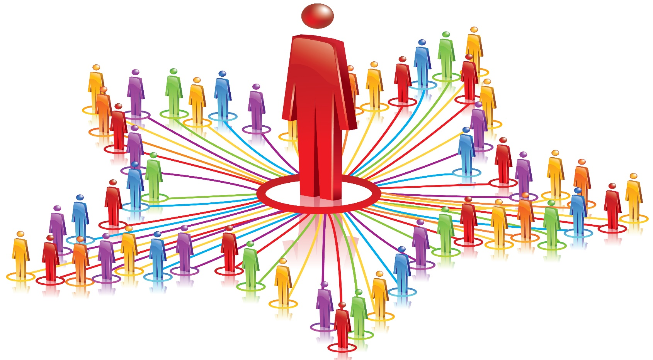
Consumer dependent

Slide 8
Consumer
In order to transform the traditional city to smart city, consumer support is mandatory to achieve success
To make Cities in India smart we need an integrated approach to modernize city infrastructure and leverage technology to improve efficiency and capacity of city services
Smartness in a city lies in integration of the core city sub systems and enabling seamless service delivery
Digital master plans have to be dovetailed into City Master Development Plans

Slide 9

Phases of Smart City

Slide 10
Bicycle Sharing System
Bike sharing can be ideal element of smart city as they have potential to impact at multiple levels
Putting sensor at every corner of city is not alone enough to make city smart ,addressing various social, economic and environmental issues, creating sustainable economic development and high quality of life
Benefit of using bicycle is to reduce air pollution and cut carbon as well as calories
Accessible and affordable personal transportation is a key condition of economic development within cities

Slide 11
Dynamic Car Pooling
Real-time ridesharing (Dynamic Car Pool) is a service that arranges one-timeshared rides on very short notice. This type of carpooling generally makes use of three recent technological advances:
GPS navigation devices to determine a driver's route and arrange the shared ride
Smartphones for a traveler to request a ride from wherever they happen to be
Social networks to establish trust and accountability between drivers and passengers
These elements are coordinated through a network service, which can instantaneously handle the driver payments and match rides using an optimization algorithm.

Slide 12
Administration dependent phases

Slide 13
Public and private transportation
City transportation is an important pillar for quality of life of citizens in a city.
Currently, in most of the cities, public and private road transportation are the key mode of commuting and logistics.
Some large and mega cities have metro and local train network as the backbone transportation mode.
Lack of quality and safe public transportation, inadequate capacity of public transportation, road safety concerns, overcrowded road network, poor traffic management, parking issues, theft, poor road conditions, lack of modal options (including pedestrian walkways) remain the key issues in most of the cities.
Most cities also lack the integrated transportation plans leading to huge demand-supply gap and poor transportation network. For transport operators, huge demand-supply gap, under recovery and poor asset management remain the key issues.

Slide 14
Surveillance systems
Freight ICT services: Freight ICT applications can help save time and energy by improving the efficiency of freight vehicle operations including processes at entry and exit and making better use of the freight network.
ICT brings the potential for
virtually unlimited data collection,
greatly enhanced predictive capabilities, and
real-time, dynamic decision-making and implementation which lead to a more efficient freight system based on completely visible and accessible physical and digital networks.
Electric vehicles: Support electricity and renewable energy operated cars with the required infrastructure. Make a few cities as pilot for "Plug-in" ready cities by facilitating the expansion of a Public Electric Vehicle (EV) infrastructure that ensures the safe, reliable, and efficient integration of EV charging loads with the power grid.

Slide 15
Smart Route
Single fare card :Single fare card for fare payment on the various participating public transportation systems. The cards can be recharged by mobile applications/internet/retail outlets. Potential extension of the cards could also be for street parking.
Smart parking: A smart parking leverages parking sensors, cameras, smart parking solution, etc. to provide efficient management of on street and off street parking spaces.
Smart toll: Smart toll leverages technology like number plate detection, RFID, etc. to charge toll fees to user account so that vehicles do not have to wait at toll gates on local, national and state highway.
Smart traffic lights: Smart traffic lights leverages technology to sense traffic condition to tune traffic lights which enable smooth flow of traffic.

Slide 16
GPS based tracking and route information of public transport
Advanced vehicle tracking solutions enhances operations and optimizes public transportation and ridership.
These solutions offer real-time GPS tracking from mobile devices thus increasing the reliability of public transportation.
The greater use of public transport will thus lead to increase in economic development and help in clean city vision to a larger extent

Slide 17
Smart Toll
Road user charges are direct charges levied for the use of roads,
including road tolls,
distance or time-based fees,
congestion charges and
charges designed to discourage use of certain classes of vehicle, fuel sources or more polluting vehicles.
These charges help to reduce peak hour travel and the associated traffic congestion or other social and environmental negative externalities associated with road travel such as
air pollution,
greenhouse gas emissions, and visual intrusion, noise and road accidents.
It can be leveraged in certain busy areas or selected cities to discourage private transport usage.

Slide 18
Video analytics and surveillance
As the public transit population grows, it becomes increasingly important to launch surveillance system on the public transport,
for e.g. buses, mass transit railway, underground, and trains to secure public transportation.
The administrators can monitor the public transport remotely and take action against any accidents/incidents.
The video footage can also be used as legal evidence against damage or criminal action on the public transport.

Slide 19
Smart Infotainment Portal
The system can include various features such as transport from one place to other in the city, houses available for rent and sell in particular area, carpooling from one point to other at a particular time
Transport- Timetables of pmpl, metrozip , info about Ola, uber, cabs, taxis, jugnoo
Events :- Things to do in city, various public parks and places to go around
Tickets:- book tickets for rail, bus, metrozip bus and other event tickets
Projects: -it will include various projects and initiatives undertaken by ngos and municipal organizations.

Slide 20
Smart Infotainment Portal contd.
Government help-box:
An ATM type application capable on working with speech which will provide information on government related services provided to people, income tax, driving license, insurance.
A person can apply for any license like driving licence, aadhar card, birth certificate and various other government docs.
Policy tender – basically providing single system to the consumer for reaching govt.
Travel:
People can book the nearest available resort or hotel and travel to nearby hill station.

Slide 21
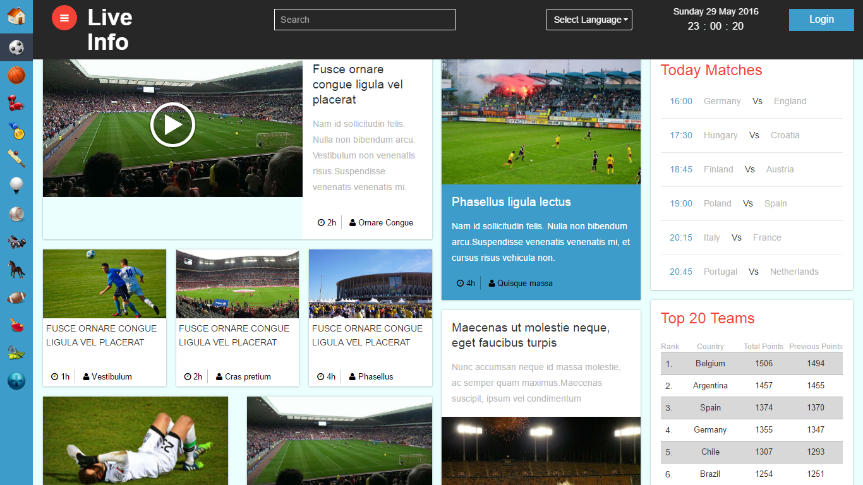

Slide 22
Clean City Smart City
E-wallet: a one stops solution to travel for public transport including rail, cab and bus
Clean city:
Waste management system and awareness on environment through Social Media and use of advanced technologies as well as advertisements and campaigns through social living drive
Emergency and Security System:
Through the use of IOT the smart device can help in security and emergency situations
Example: weather detecting drones with LI-Fi connectivity

Slide 23
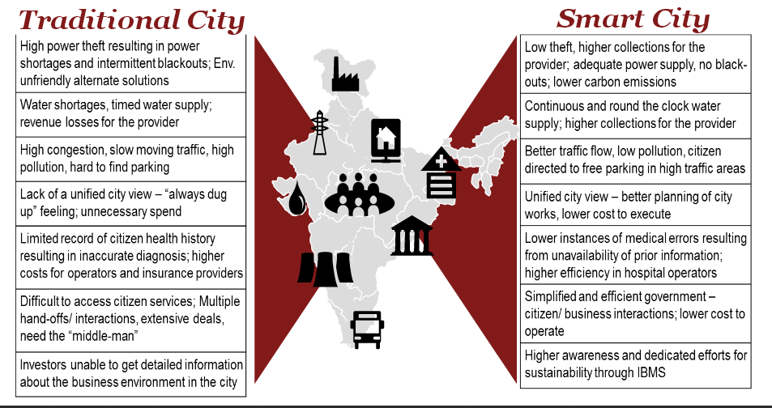
Traditional City vs Smart City

Slide 24
Benefits of Smart City
Better city planning and development
E-government services delivered to citizens, faster, and at a lower operating expense
Local economic development
Improved productivity and service

Slide 25
Advantages
Waste management
Water management
Energy
Mobility

Slide 26
Advantages (Waste and Water Mgmt)
Waste management
Waste to energy & fuel
Waste water to be treated
Recycling & reduction of waste
Water Management
Smart meters
Leakage identification & prevention
Water quality monitoring

Slide 27
Advantages contd.(Energy & Mobility)
Energy
Smart meters
Green buildings
Renewable sources of energy
Mobility
Smart parking
Intelligent traffic management
Integrated multi-modal transport

Slide 28
Conclusion
With all the effort and support of people the city will be able to transform in smart city, thus making the environment clean and increasing the overall development of country

Slide 29
Thank you

